Slide 1
Artificial Intelligence CS-202
Topic: Expert Systems
Habiba Arshad
Department of Computer Science
University of Wah

Slide 2

Today’s Goal
Understand what expert systems are and their role in AI.
Learn the components that make up expert systems.
Discover how expert systems operate.
Explore various applications of expert systems in different fields.
Recognize the advantages and limitations of using expert systems.
Gain insights into the future of expert systems in AI.

Slide 3
What are Expert Systems?
An expert system is a type of computer program that acts like a human expert. It is designed to solve complex problems and make decisions, just like a person who is highly skilled in a certain field.

Slide 4
Key Features
Expert systems are the most mature and widely used commercial field of Artificial Intelligence.
Expert systems are systems that employ a codification of human expertise to solve problems
Expert systems are a branch of AI designed to emulate the decision-making capabilities of human experts.
It solves the most complex issues as an expert by extracting the knowledge stored in its knowledge base.

Slide 5
Key Features
Expert systems are built for specific areas (called domains) like medicine, science, or engineering.
The more knowledge the system has, the better and smarter it becomes.
It uses both facts and experience-based rules (heuristics) to make decisions like a human expert.
A simple example is when you type in the Google search box, and it suggests the correct spelling – that’s an expert system helping you based on its knowledge of common typing errors.
Real-life Example

Slide 6
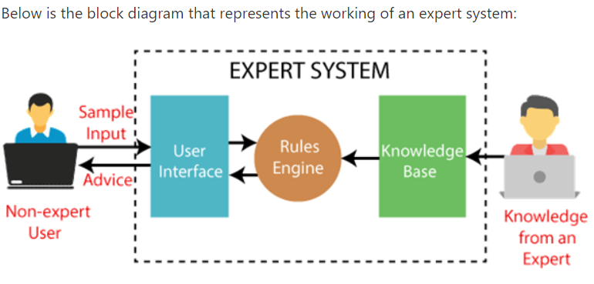
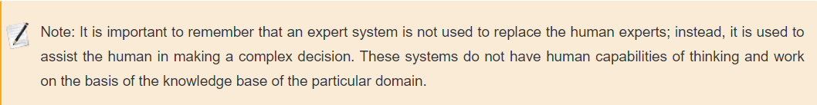
Notes:
User Interface
This is where the user interacts with the system by asking questions or providing input.
Knowledge Base
Contains expert knowledge in the form of facts, rules, and data about a specific field (like medicine, science, etc.).
Inference Engine (Rules Engine)
The brain of the expert system.
It analyzes the input from the user, applies logical rules, and draws conclusions using the knowledge base.
Response to User
The system provides the solution, advice, or recommendation based on its reasoning.

Slide 7
Characteristics of Expert System
High Performance: The expert system provides high performance for solving any type of complex problem of a specific domain with high efficiency and accuracy.
Understandable: It responds in a way that can be easily understandable by the user. It can take input in human language and provides the output in the same way.
Reliable: It is much reliable for generating an efficient and accurate output.
Highly responsive: ES provides the result for any complex query within a very short period of time.

Slide 8
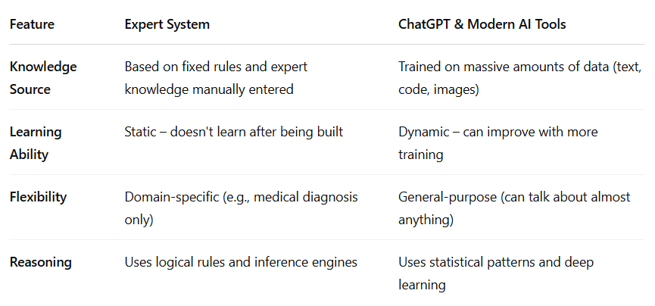

Slide 9
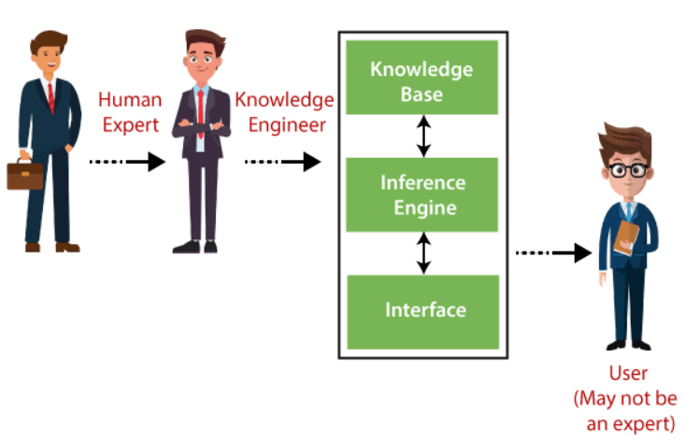
Components of Expert System
An expert system mainly consists of three components:
User Interface
Inference Engine
Knowledge Base

Slide 10
1. User Interface
With the help of a user interface
the expert system interacts with the user
takes queries as an input in a readable format, and
passes it to the inference engine.
After getting the response from the inference engine, it displays the output to the user.
In other words, it is an interface that helps a non-expert user to communicate with the expert system to find a solution.

Slide 11
1. User Interface
For instance, a medical expert system’s user interface might include
Forms for entering patient symptoms
History
Dashboards displaying diagnostic results
Treatment recommendations.

Slide 12
2. Inference Engine(Rules of Engine)
The inference engine is known as the brain of the expert system as it is the main processing unit of the system.
It applies inference rules to the knowledge base to derive a conclusion or deduce new information.
It helps in deriving an error-free solution of queries asked by the user.
With the help of an inference engine, the system extracts the knowledge from the knowledge base.

Slide 13
2. Inference Engine(Rules of Engine)
There are two types of inference engine:
Deterministic Inference engine: The conclusions drawn from this type of inference engine are assumed to be true. It is based on facts and rules.
Probabilistic Inference engine: This type of inference engine contains uncertainty in conclusions, and based on the probability.

Slide 14
2. Inference Engine(Rules of Engine)
Inference engine uses the below modes to derive the solutions:
Forward Chaining: It starts from the known facts and rules, and applies the inference rules to add their conclusion to the known facts.
Backward Chaining: It is a backward reasoning method that starts from the goal and works backward to prove the known facts.

Slide 15
Example Forward Chaining
Use case: Diagnosing a disease.
🔹 Known Facts:
The patient has a high fever.
The patient has a cough.
🔹 Rules in the Knowledge Base:
Rule 1: IF a person has a high fever AND cough, THEN the person might have the flu.
Rule 2: IF a person has the flu, THEN recommend rest and fluids.
How it works (Forward Chaining):
Start with known facts: high fever and cough.
Apply Rule 1 → conclude: the person might have the flu.
Apply Rule 2 → recommend: rest and fluids.
Starts from facts → moves forward to conclusions.

Slide 16
Example (Backward Chaining)
Use case: Proving if someone has the flu.
🔹 Goal (what we want to prove):
Does the patient have the flu?
🔹 Rules in the Knowledge Base:
Rule 1: IF a person has a high fever AND cough, THEN the person might have the flu.
How it works:
Start with goal: does the person have the flu?
Check what conditions must be true → Rule 1 says: high fever AND cough.
Ask the user or database: Does the person have these symptoms?
If yes → goal is confirmed.
If no → goal is not confirmed.
Starts from a goal → works backward to find supporting facts.

Slide 17
3. Knowledge Base
The knowledge base is a type of storage that stores knowledge acquired from the different experts of the particular domain.
Containing all the information and rules, facts, and relation required for the solution of problems in a specific domain
e.g. in medical diagnosis, the knowledge base would involve medical conditions, symptoms, diagnostics and treatment.

Slide 18
3. Knowledge Base (Components)
Factual Knowledge: The knowledge which is based on facts and accepted by knowledge engineers.
Example:
"Normal human body temperature is 98.6°F."
"Fever is defined as a body temperature above 100.4°F."
These are solid facts that all doctors agree on.
Heuristic Knowledge: This knowledge is based on practice, the ability to guess, evaluation, and experiences.
Example:
"If a patient has a sore throat, mild fever, and no cough, it might be strep throat."
"Patients over 60 with chest pain are more likely to have heart-related issues."
This is what a doctor learns through experience, not just textbooks.

Slide 19
3. Knowledge Base (Components)
Knowledge Representation: It is used to formalize the knowledge stored in the knowledge base using the If-else rules.
Example (IF-THEN rule):
IF the patient has a fever AND cough, THEN suggest possible flu.
IF chest pain occurs after exercise, THEN suggest testing for angina.
This is how knowledge is coded into the system so the inference engine can use it.

Slide 20
3. Knowledge Base (Components)
Knowledge Acquisitions: It is the process of extracting, organizing, and structuring the domain knowledge, specifying the rules to acquire the knowledge from various experts, and store that knowledge into the knowledge base.
Example:
A medical expert sits with a knowledge engineer and explains how they diagnose flu.
The engineer writes rules like:
“IF fever > 100.4°F AND muscle aches AND fatigue → THEN flu.”
This is how real-world expert insights become part of the expert system.

Slide 21
Participants in the development of Expert System
There are three primary participants in the building of Expert System:
Expert: The success of an ES much depends on the knowledge provided by human experts. These experts are those persons who are specialized in that specific domain.
Knowledge Engineer: Knowledge engineer is the person who gathers the knowledge from the domain experts and then codifies that knowledge to the system according to the formalism.
End-User: This is a particular person or a group of people who may not be experts, and working on the expert system needs the solution or advice for his queries, which are complex.

Slide 22
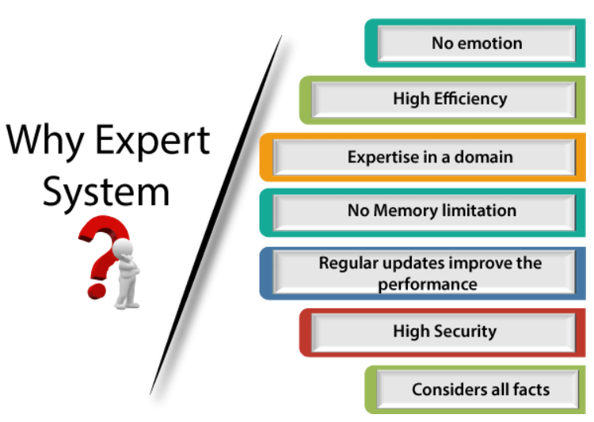
Notes:
Expert systems offer several advantages that make them highly valuable in various domains

Slide 23
Expert System’s vs Human Experts
No memory Limitations: It can store as much data as required and can memorize it at the time of its application. But for human experts, there are some limitations to memorize all things at every time.
High Efficiency: If the knowledge base is updated with the correct knowledge, then it provides a highly efficient output, which may not be possible for a human.
Expertise in a domain: There are lots of human experts in each domain, and they all have different skills, different experiences, and different skills, so it is not easy to get a final output for the query. But if we put the knowledge gained from human experts into the expert system, then it provides an efficient output by mixing all the facts and knowledge

Slide 24
Expert System’s vs Human Experts
Not affected by emotions: These systems are not affected by human emotions such as fatigue, anger, depression, anxiety, etc.. Hence the performance remains constant.
High security: These systems provide high security to resolve any query.
Considers all the facts: To respond to any query, it checks and considers all the available facts and provides the result accordingly. But it is possible that a human expert may not consider some facts due to any reason.
Regular updates improve the performance: If there is an issue in the result provided by the expert systems, we can improve the performance of the system by updating the knowledge base.

Slide 25

How Expert Systems Operate
Expert systems follow a structured process to emulate human decision-making:
Input: Users input data or questions through the user interface.
Knowledge Application: The inference engine processes this data using the rules and facts stored in the knowledge base.
Reasoning: The system applies logical reasoning to draw conclusions or provide recommendations.
Output: The system presents the solution or advice to the user, often with an explanation of how it arrived at the conclusion.

Slide 26
Applications of Expert Systems
Expert systems follow a structured process to emulate human decision-making:
Financial Services:
help in the decision-making process in investments, evaluation of risks, and identification of fraud.
Engineering:
Aids in development of methods, identification of problems and improvement on the existing procedures.
Customer Support:
To deliver expert-level automated response to customers’ questions and requests.
Agriculture:
Help the farmers with techniques regarding their crops, pest, and soils among others.

Slide 27
Applications of Expert System
In designing and manufacturing domain
It can be broadly used for designing and manufacturing physical devices such as camera lenses and automobiles.
In the finance domain
In the finance industries, it is used to detect any type of possible fraud, suspicious activity, and advise bankers that if they should provide loans for business or not.
In the diagnosis and troubleshooting of devices
In medical diagnosis, the ES system is used, and it was the first area where these systems were used.
Planning and Scheduling
The expert systems can also be used for planning and scheduling some particular tasks for achieving the goal of that task.

Slide 28
Future of Expert Systems
Traditional expert systems are rule-based and don’t learn on their own. In the future, they’ll be enhanced by machine learning, allowing them to learn from new data and improve automatically.
Will be used more widely in fields like: Healthcare (faster diagnosis), Finance (fraud detection, investment advice), Agriculture (crop management), Education (personalized tutoring)
Expert systems will be available on the cloud, making them accessible from anywhere and easier to update and scale.
Future expert systems will be more user-friendly, using natural language processing to communicate with users in a more natural, human-like way.
Expert systems will work alongside other AI models like deep learning, neural networks, and big data systems to handle more complex and dynamic problems.

Slide 29
Advantages of Expert Systems
Consistency:
They provide consistent answers, reducing human error.
Availability:
Accessible 24/7, providing continuous support.
Efficiency:
Quickly process vast amounts of data to offer timely solutions.
Cost-Effective:
Reduce the need for human experts, lowering operational costs.

Slide 30

Limitations of Expert Systems
Lack of Common Sense:
They cannot understand context beyond their programmed knowledge.
Maintenance:
Require regular updates to the knowledge base.
Limited Creativity:
Cannot generate innovative solutions beyond their programmed rules.
Dependency on Quality of Data:
The accuracy of their advice depends on the quality of the data in the knowledge base.

Slide 31

Questions

